Slide 1
Technology for Digital Learning & Online Assessments

Slide 2
Goals and Expected Outcomes
Goals:
Discuss online readiness for digital learning and assessments
Discuss PARCC Technology Guidelines
Describe PARCC Technology Readiness Tools (TRTs)
Expected Outcomes:
Know what is meant by online readiness
Be able to access the PARCC Technology website
Understand efforts and resources underway and available intended to ensure PARCC Technology Readiness for all school districts in the Arkansas

Slide 3
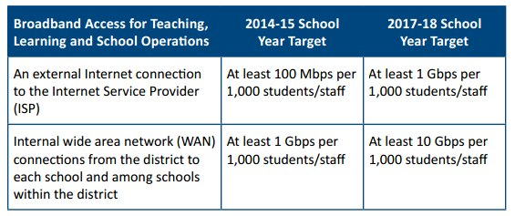
Arkansas and Online Readiness
State Educational Technology Directors Association (SETDA) recommendations

Slide 4
SETDA on Bandwidth
Additional bandwidth will be required for most K-12 districts in the country in order to provide enhanced K-12 teaching and learning and
Online content
Applications
Functionality

Slide 5
SETDA Recommendations
Address Broadband Infrastructure
Minimum target by 2017-18 of 1 Gbps per 1000/students
Ensure Universal Broadband Access
Build State Leadership
Advocate for Federal Funding
The U.S. ranks 15th among industrialized countries in access to high-speed internet

Slide 6
Digital Readiness
Includes assessments but is much more:
It is a multi‐year transition process.
Involves an in‐depth needs analysis, planning, communication, involvement of stakeholders, as well as,
training and hands‐on experiences for students and staff.

Slide 7
Student Readiness
= technological proficiency
Students have necessary skills and experience to learn and be assessed online.
To accomplish this, students use educational technology to actively learn the content and to demonstrate understanding of the content.
It involves using educational technology to not only gather, remember and understand information but to also analyze, evaluate and create information incorporating what was learned.

Slide 8
Student Readiness
Student are technological proficient.
Students have access to educational technology and the Internet.
Students need experience with online assessments.

Slide 9
Teacher Readiness
Teachers have necessary skills and experience.
Use educational technology so students can actively learn the content and demonstrate understanding of the content.
Use educational technology to assess student learning and to inform instruction.
Be comfortable with a classroom of students using devices…includes ability to assist with troubleshooting
Have technological proficiency
Have access to technology and the Internet
Have experience with online assessments

Slide 10
Administrator Readiness
Administrators facilitate online readiness.
Facilitate conversations with stakeholders (community, Board, families)
Actively participate in the development of an overarching implementation plan that is aligned to curricular and infrastructure needs
Ensure that students and staff have the necessary resources for digital learning and online assessments
Provide a unified vision and implementation for all schools within the district – everyone has a role
Ensure that the logistics, environments and technical support services are components of the implementation plan

Slide 11
Site Readiness
What locations would be used for online assessments?
How many students would these locations accommodate at one time?
Are there locations that can be temporarily set up for administering online assessments?
Who would do it and how would it be done?
What devices would be used for the online assessments?
How much would it cost to set up and break down the location and devices?
How much time is needed for set up and break down?
What could be done ahead of time to prepare the location and devices?

Slide 12
Device Readiness
What devices will be used for online assessments?
How many students will these devices serve at one time?
Where are these devices located?
Do any of them need to be gathered and set up in a temporary location for online assessments? If so:
Who would do it?
How would it be done?
What is the amount of time needed to gather, prepare and deploy?
What are the costs involved?

Slide 13
Bandwidth Readiness
What is the current bandwidth for each student/user on the network/Internet when the network/Internet services are at full capacity?
How many students can be on the network/Internet at the same time when it is at full capacity?
What would the upload and download speeds be for each student?

Slide 14
Bandwidth Readiness
Does this amount of bandwidth and speed support teaching, learning and online assessments?
If not:
Upgrade services?
Limit the number of students on network?
What would that number be?
Do both?

Slide 15
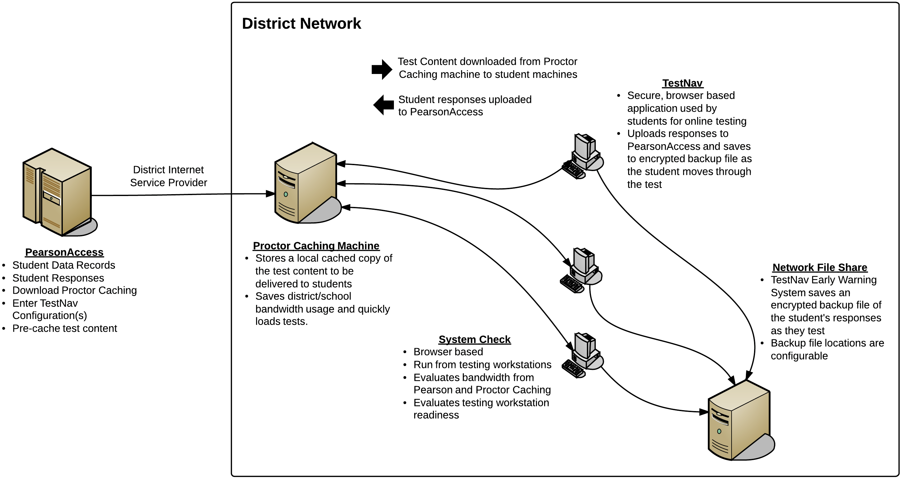
PARCC Testing Overview

Slide 16
Resources for PARCC Field Test Technology Readiness
Most schools should be able to meet the requirements, since relatively few students need to be tested at one time and there is a long testing window. Even schools with a relatively few computers and limited access to the internet should be able to participate.

Slide 17

Technology Readiness for Field Test: Quick Start Checklist
1. | NUMBER OF TEST TAKERS: Estimate the maximum number of students that will be testing at one time. Consider how the school might schedule classes of students for field testing. This may be multiple classrooms at a time over a shorter period, or only one class at a time — or even half a class at a time—over the course of the full testing window. Districts/schools will have flexibility to match their schedule to their computer capacity as long as they can complete the field tests within the testing window.
2. | AVAILABLE DEVICES: Identify the school computers that will be available for testing. Review the PARCC Technology Guidelines and verify that there will be an adequate number of school computers that meet PARCC minimum specifications to cover the largest number of students that will be testing at one time. If there seems to be a gap, schools can consider dividing classes into smaller groups to test at different times using the available computers throughout the testing window.
3. | BANDWIDTH: Plan to use Proctor Caching and have at least 5 kbps of bandwidth for each student testing at the same time. OR Plan for at least 50 kbps of bandwidth for each student connecting to the Internet for testing at the same time.

Slide 18
General Requirements for Desktop, Laptop, Netbook, and Thin Client/VDI Computers
Operating System | Supported for Spring 2014 Field Test | Supported for 2014-2015 Operational Assessment | Minimum Specifications | Recommended Specifications
Windows | Yes | Yes | Windows XP – Service Pack 3 | Windows 7 or newer
Mac OS | Yes | Yes | Mac OS 10.5 | Mac OS 10.7 or newer
Linux | No | Yes | Ubuntu 9-10, Fedora 6 | Linux: Ubuntu 11.10, Fedora 16 or newer
Chrome OS | Yes¹ | Yes¹ | Chrome OS 19 | Chrome OS 19 or newer
For all details about device specifications, please see the Full Technology Specifications for PARCC Spring 2014 Field Test available on www.parcconline.org/field-test-technology
¹ For the Field Test, not all accessibility features for students with disabilities will be
supported for Chrome OS. All features will be supported for the 2014-2015
Operational Year.

Slide 19
General Requirements for Tablets
Operating System | Supported for Spring 2014 Field Test | Supported for 2014-2015 Operational Assessment | Minimum Specifications | Recommended Specifications
Android | No | Yes | Android 4.0 | Android 4.0 or newer
Apple iOS | Yes | Yes | iPad 2 running iOS 6 | iPad 2 or newer running iOS6 or newer
Windows Tablets | Yes¹ | Yes¹ | Windows 8 | Windows 8 or newer
Tablet screen size must be 9.5 inches (10 inch class) or larger. In addition, external keyboards (wired or bluetooth) are required for tablets. For all details about device specifications, please see the Full Technology Specifications for PARCC Spring 2014 Field Test available on www.parcconline.org/field-test-technology
¹ Windows RT will not be supported for Field Test. It is unknown if Windows RT
will be supported for the 2014-2015 Operational Assessment.

Slide 20
School Bandwidth for Testing
 | Minimum Connection Speed (External Connection to the Internet)
Simultaneous Test-Takers/Devices | With Caching (5 kbps/student) | Without Caching (50 kbps/student)
15 students/devices | 75 kbps | 750 kbps
20 students/devices | 100 kbps | 1000 kbps (1 mbps)
30 students/devices | 150 kbps | 1500 kbps (1.5 mbps)
60 students/devices | 300 kbps | 3000 kbps (3 mbps)
90 students/devices | 450 kbps | 4500 kbps (4.5 mbps)

Slide 21
PARCC Tech Resources
www.techreadiness.net
Technology Readiness Tool (TRT) Site
http://www.parcconline.org/technology
PARCC Capacity Planning Tool
http://practice.parcc.testnav.com
System Check Tool
Proctor Caching Software
PARCC Training Modules
Technology
Test Administration
Sample Items

Slide 22
ADE Tech Resources
http://ideas.aetn.org/commoncore/assessment
PARCC Field Test Overview
PARCC Technology Requirements
PARCC Assessment Resources
Technology Set Up
Administrator Training
Accessibility Features and Accommodations with Computer-Based Testing
PARCC Accessibility Features and Accommodations Manual
Student Data Upload Training utilizing COGNOS

Slide 23
Combined State Effort
K-12 Tech Readiness Team
Division of Information Systems (DIS)
APSCN LAN / Remote Field Support
Educational Service COOP Tech Coordinators

Slide 24
Q&A

Slide 25
Contact Information
Jimmy Blevins
Assessment Specialist
(501) 682-5752
Jimmy.Blevins@arkansas.gov

